Slide 1
LESSON 24

Slide 2
Overview
of
Previous Lesson(s)

Slide 3
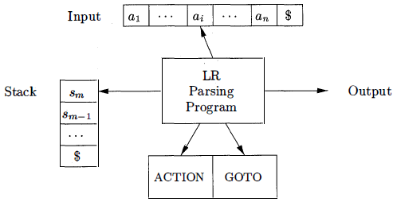
Over View
LR parser
It consists of an input an output a stack a parsing program & a parsing table that has two parts (ACTION and GOTO)

Slide 4
Over View…
Structure of the LR Parsing Table
It consists of two parts: a parsing-action function ACTION and a goto function GOTO.
Given a state i and a terminal a or the end-marker $ ACTION[i,a] can be
Shift j The terminal a is shifted on to the stack and the parser enters state j.
Reduce A → α The parser reduces α on the TOS to A.
Accept
Error

Slide 5
Over View…
The prefixes of right sentential forms that can appear on the stack of a shift-reduce parser are called viable prefixes
A viable prefix is a prefix of a right-sentential form that does not continue past the right end of the rightmost handle of that sentential form.
By this definition, it is always possible to add terminal symbols to the end of a viable prefix to obtain a right-sentential form.
SLR parsing is based on the fact that LR(0) automata recognize viable prefixes.

Slide 6
Over View…
By extending the previous LR parsing techniques to use one symbol of look-ahead on the input.
Two different methods:
The "canonical-LR" or just "LR" method, which makes full use of the look-ahead symbol(s) . This method uses a large set of items, called the LR(1) items.
The "look-ahead-LR" or "LALR" method, which is based on the LR(0) sets of items, and has many fewer states than typical parsers based on the LR(1) items.

Slide 7
Over View…
SLR used the LR(0) items that is the items used were productions with an embedded dot, but contained no other (look-ahead) information.
The LR(1) items contain the same productions with embedded dots, but add a second component, which is a terminal (or $).
This additional component becomes important only when the dot is at the extreme right (indicating that a reduction can be made if the input symbol is in the appropriate FOLLOW set).

Slide 8
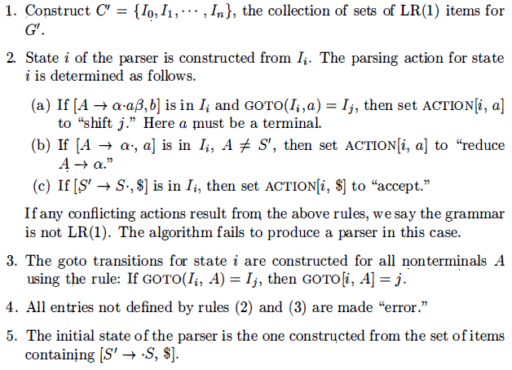
Over View…
METHOD used for constructing LR(1) Items:

Slide 9
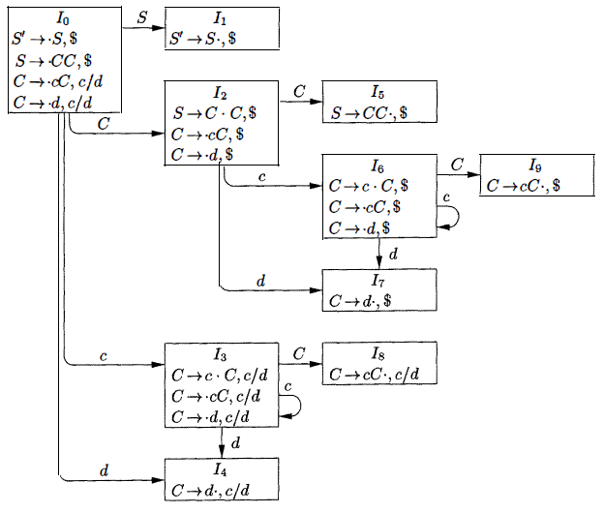
Over View…
0. S’ → S
1. S → C C
2. C → c C
3. C → d

Slide 10
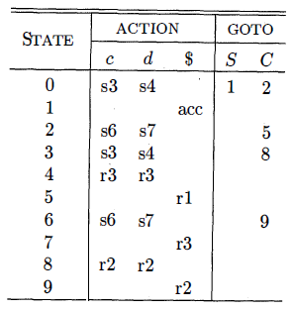
Over View…
Canonical parsing table for our example grammar:

Slide 11
TODAY’S LESSON

Slide 12
Contents
Powerful LR Parsers
Canonical LR(1) Items
Constructing LR(1) Sets of Items
Canonical LR(1) Parsing Tables
Constructing LALR Parsing Tables
Efficient Construction of LALR Parsing Tables
Compaction of LR Parsing Tables
Ambiguous Grammars
Precedence and Associativity t o Resolve Conflicts
The "Dangling-Else" Ambiguity
Error Recovery in LR Parsing

Slide 13
LALR Parsing Tables
LALR: our last parser construction method.
This method is often used in practice, because the tables obtained by it are considerably smaller than the canonical LR tables.
The same is almost true for SLR grammars, but there are a few constructs that cannot be conveniently handled by SLR techniques
For a comparison of parser size, the SLR and LALR tables for a grammar always have the same number of states.
This number is typically several hundred states for a language like C.
The canonical LR table would typically have several thousand states for the same-size language.

Slide 14
LALR Parsing Tables..
For LALR we merge various LR(1) item sets together obtaining nearly the LR(0) item sets we used in SLR.
LR(1) items have two components, the first, called the core, is a production with a dot; the second a terminal.
For LALR we merge all the item sets that have the same cores by combining the 2nd components (thus permitting reductions when any of these terminals is the next input symbol).
So, we obtain the same number of states (item sets) as in SLR since only the cores distinguish item sets.

Slide 15
LALR Parsing Tables...
Unlike SLR, we limit reductions to occurring only for certain specified input symbols.
LR(1) gives finer control, it is possible for the LALR merger to have reduce-reduce conflicts when the LR(1) items on which it is based is conflict free.
These conflicts are possible but they are rare and the size reduction from LR(1) to LALR is quite large.
LALR is the current method of choice for bottom-up, shift-reduce parsing.

Slide 16
LALR Parsing Tables...
To understand it better, let us consider our previous grammar and its sets of LR(1) items.
Take a pair of similar looking states, such as 1₄ and I₇
Each of these states has only items with first component C → d∙
Lookaheads
I₄ = c or d, I₇ = $
S’ → S
S → C C
C → c C
C → d

Slide 17
LALR Parsing Tables...
Now we can replace I₄ and I₇ by I₄₇ the union of I₄ and I₇ consisting of the set of three items represented by [C → d∙ , c/d/$]
The goto's on d to I₄ or I₇ from I₀ , I₂ , I₃ & I₆ now enter I₄₇
The action of state 47 is to reduce on any input.
So now we look for sets of LR(1) items having the same core, that is, set of first components, and we may merge these sets with common cores into one set of items

Slide 18
LALR Parsing Tables...
States Core
I₄ & I₇ C → d∙
I₃ & I₆ C → c∙C
C → ∙cC
C → ∙d
I₈ & I₉ C → cC∙

Slide 19
LALR Parsing Tables...
Core of GOTO(I, X) depends only on the core of I, the goto's of merged sets can themselves be merged.
Thus, there is no problem revising the goto function as we merge sets of items.
The action functions are modified to reflect the non-error actions of all sets of items in the merger.
Easy but space-consuming LALR table construction
INPUT: An augmented grammar G' .
OUTPUT: The LALR parsing-table functions ACTION and GOTO for G' .

Slide 20
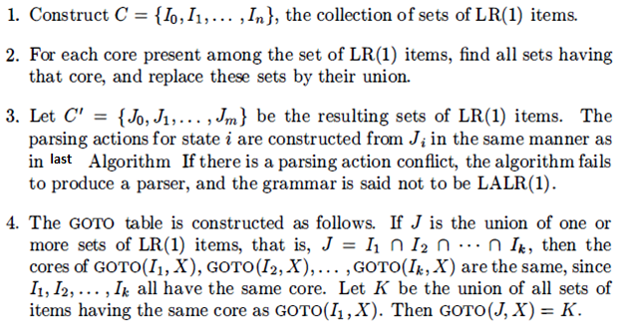
LALR Parsing Tables...
METHOD:

Slide 21
LALR Parsing Tables...
Ex: Merged States
I₄ ₇ = I₄ & I₇ C → d∙ , c/d/$
I₃₆ = I₃ & I₆ C → c∙C , c/d/$
C → ∙cC , c/d/$
C → ∙d , c/d/$
I₈₉ = I₈ & I₉ C → cC∙ , c/d/$

Slide 22
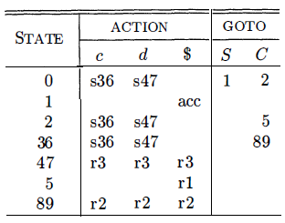
LALR Parsing Tables...
Canonical parsing table LALR parsing table

Slide 23
Efficient Construction of LALR Parsing Tables
There are several modifications we can make to LALR table construction Algorithm to avoid constructing the full collection of sets of LR(1) items in the process of creating an LALR(1) parsing table.
First, we can represent any set of LR(0) or LR(1) items I by its kernel, that is, by those items that are either the initial item - [S’ → ∙S] or [S’ → ∙S, $] - or that have the dot somewhere other than at the beginning of the production body.
We can construct the LALR(1) -item kernels from the LR(0)-item kernels by a process of propagation and spontaneous generation of look-aheads.

Slide 24
Efficient Construction of LALR Parsing Tables..
If we have the LALR(1) kernels, we can generate the LALR(1) parsing table by closing each kernel, using the function CLOSURE.
Then computing table entries by Construction of canonical-LR parsing table Algorithm, as if t he LALR(1) sets of items were canonical LR(1) sets of items.

Slide 25
Compaction of LR Parsing Tables
A typical programming language grammar with 50 to 100 terminals and 100 productions may have an LALR parsing table with several hundred states.
The action function may easily have 20,000 entries, each requiring at least 8 bits to encode.
On small devices, a more efficient encoding than a two-dimensional array may be important.

Slide 26
Compaction of LR Parsing Tables..
One useful technique for compacting the action field is to recognize that usually many rows of the action table are identical.
States 0 and 3 have identical action entries, and so do 2 and 6.
We can therefore save considerable space, at little cost in time, if we create a pointer for each state into a one-dimensional array.
Pointers for states with the same actions point to the same location.

Slide 27
Compaction of LR Parsing Tables..
To access information from this array, we assign each terminal a number from zero to one less than the number of terminals and we use this integer as an offset from the pointer value for each state.
In a given state, the parsing action for the ith terminal will be found i locations past the pointer value for that state.

Slide 28
Compaction of LR Parsing Tables…
Further space efficiency can be achieved at the expense of a somewhat slower parser by creating a list for the actions of each state.
The list consists of (terminal-symbol, action) pairs.
The most frequent action for a state can be placed at the end of the list, and in place of a terminal we may use the notation "any," meaning that if the current input symbol has not been found so far on the list, we should do that action no matter what the input is.
Moreover, error entries can safely be replaced by reduce actions, for further uniformity along a row.

Slide 29
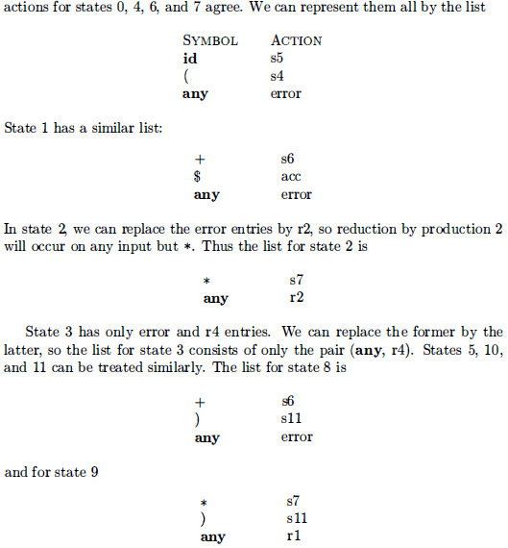
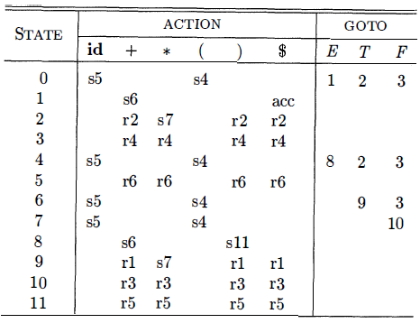
Compaction of LR Parsing Tables…
Ex.

Slide 30
Compaction of LR Parsing Tables…
We can also encode the GOTO table by a list, but here it appears more efficient to make a list of pairs for each non-terminal A.
Each pair on the list for A is of the form (currentState, nextState) indicating GOTo[currentState, A] = next State

Slide 31
Compaction of LR Parsing Tables…
This technique is useful because there tend to be rather few states in any one column of the GOTO table.
The reason is that the GOTO on non-terminal A can only be a state derivable from a set of items in which some items have A immediately to the left of a dot
No set has items with X and Y immediately to the left of a dot if X ≠ Y.
Thus , each state appears in at most one GOTO column.

Slide 32
Thank You

